Slide 1

ConvNets Classification of White Blood Cell Types
Capstone Project
Matt Xu
mattxushuai@gmail.com

Slide 2
Contents
Introduction
Data Set
Image Classification
Data Prep
Convolutional Neural Networks
My own Models
Transfer Learning
Assumptions and Limitations
Recommendations

Slide 3
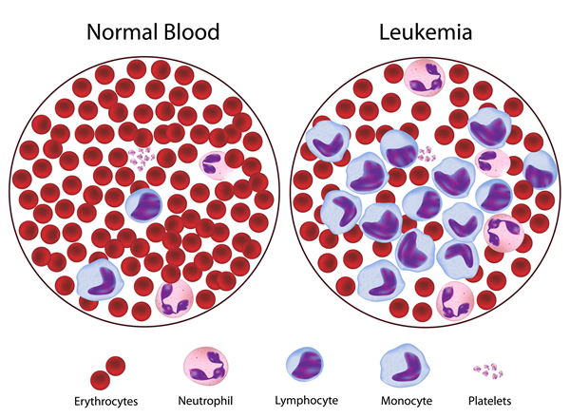
Introduction
Density of white blood cells (WBC) provides a glimpse into the state of our immune system
Dramatic change in WBC count is a sign that your body is infected by an antigen
A variation in a specific type of WBC generally correlates with a specific type of antigen
Understanding the count of WBC can provide powerful quantitative picture of one’s health

Slide 4
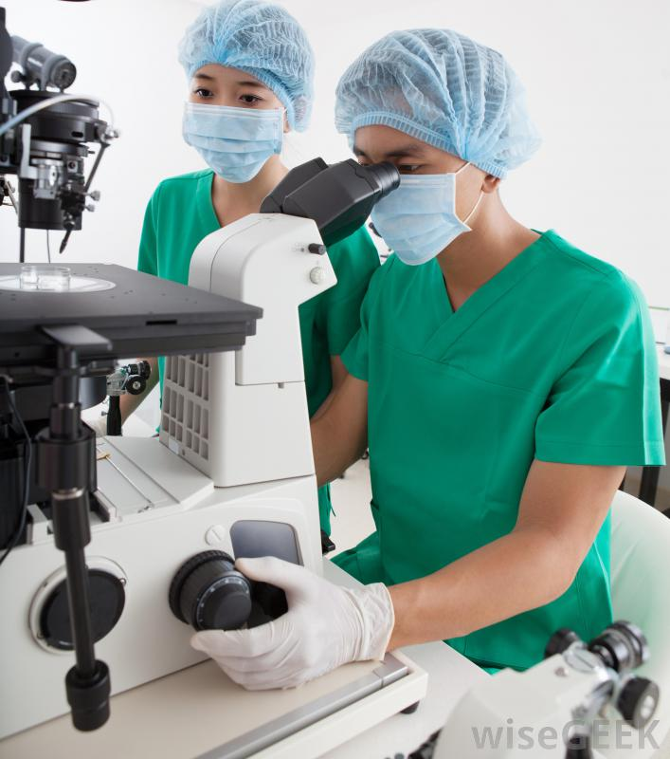
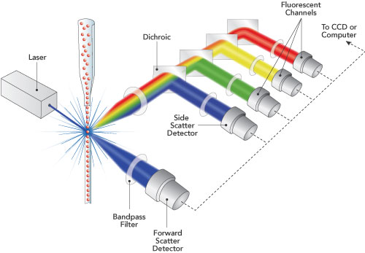
Introduction
Coulter Counter
Laser Flow Cytometers
Microscope
Classify WBC by measuring current change that is specific to WBC subtypes
Classify WBC by measuring how the laser light is refracted by the cells
Manually classify WBC by looking through a microscope

Slide 5
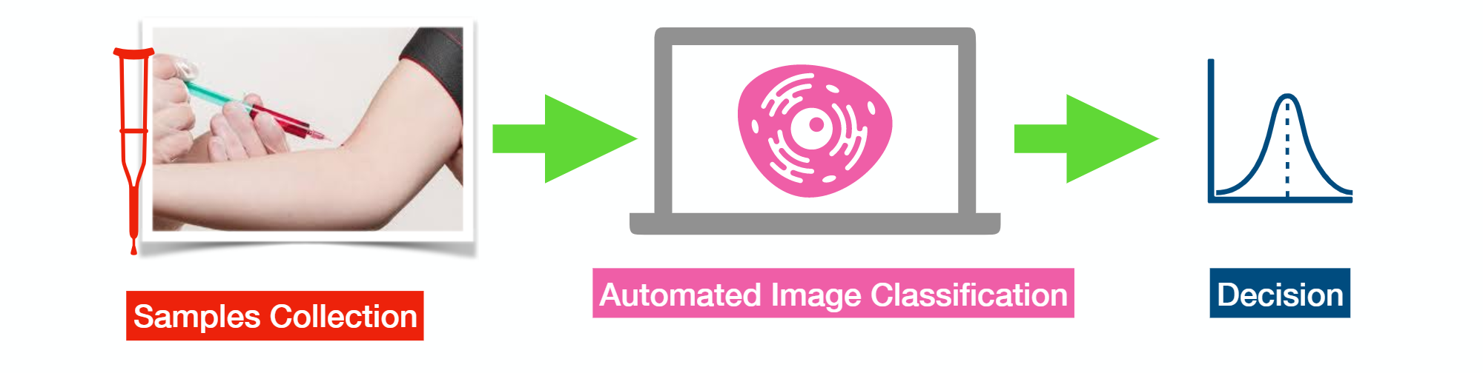
Introduction
Machine Learning
Requires far cheaper equipment
Provides results nearly instantaneously unlike current methods
Tend to improve accuracy over time as more samples are classified and counted

Slide 6
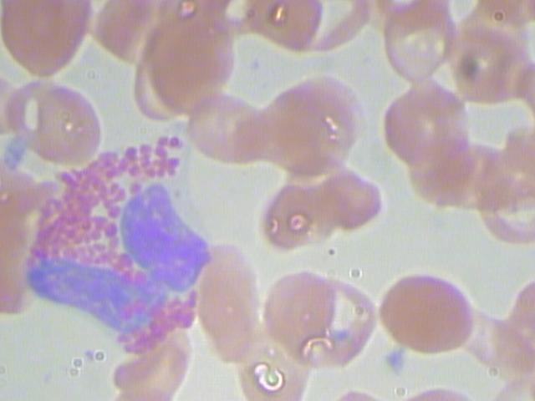
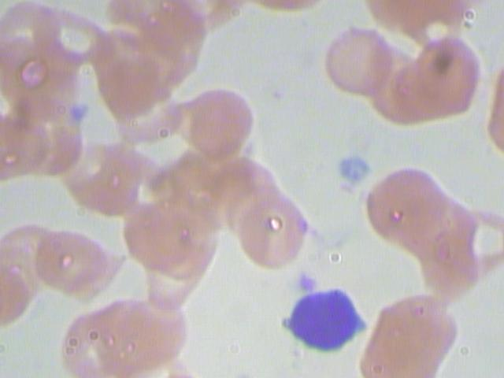
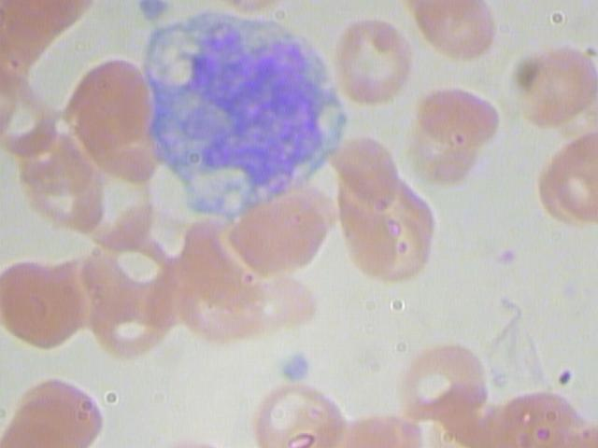
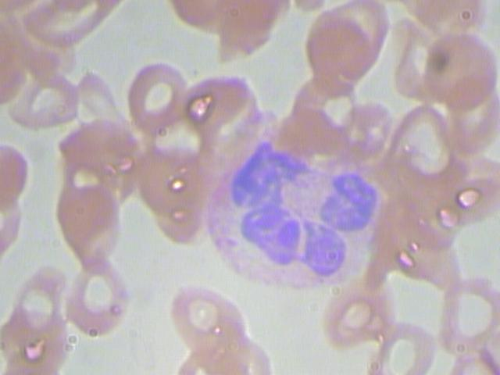
Project Goal
EOSINOPHIL
LYMPHOCYTE
MONOCYTE
NEUTROPHIL
To build and optimize image classifiers that can classify the four subtypes of white blood cells with accuracy higher than 90%

Slide 7
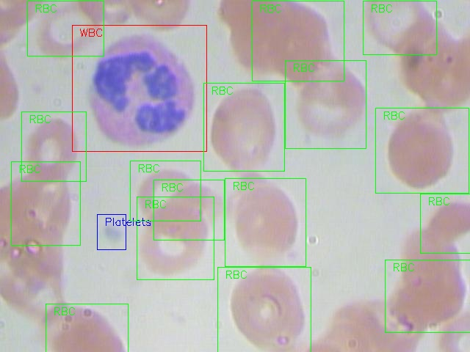
Dataset
The BCCD dataset is a small-scale dataset for blood cells detection under MIT license.
The dataset contains in total 410 images of 4 subtypes of WBC
All images are in jpeg format with Width x Height of 640 x 480
White Blood Cell
Red Blood Cell
Platelets

Slide 8
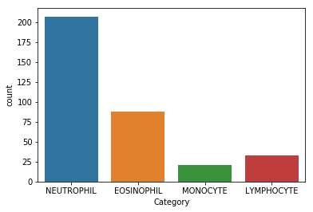
Dataset
Unbalanced Data
10 | NEUTROPHIL, EOSINOPHIL
11 | NEUTROPHIL
12 | NEUTROPHIL
13 | NEUTROPHIL
14 | NEUTROPHIL
15 | MONOCYTE
16 | NEUTROPHIL
17 | EOSINOPHIL
18 | NEUTROPHIL
19 | NEUTROPHIL
20 | LYMPHOCYTE
21 | LYMPHOCYTE
22 | NEUTROPHIL
23 | EOSINOPHIL
24 | NEUTROPHIL
25
26 | EOSINOPHIL
27
28 | EOSINOPHIL
29 | NEUTROPHIL
30 | NEUTROPHIL
31 | NEUTROPHIL,NEUTROPHIL
32 | NEUTROPHIL
Missing label
Multiple labels

Slide 9
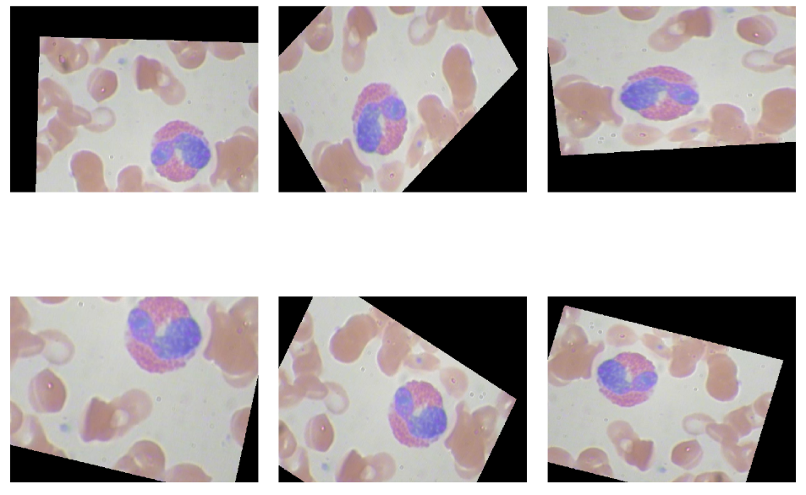
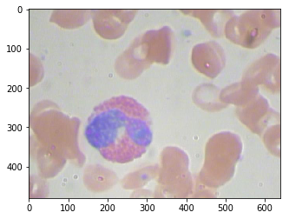
Image Augmentation
Rotation
Shifting
Shearing
Zoom in/out
Rescaling
Flipping V/H

Slide 10
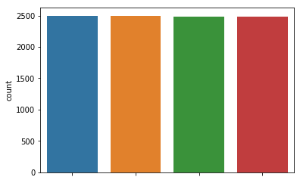
Image Augmentation
Training / Validation / Testing = 60 / 20 / 20

Slide 11
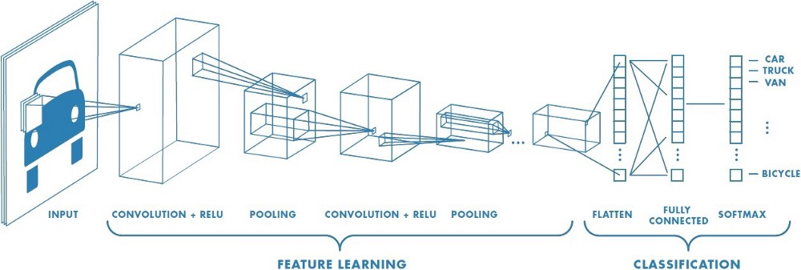
Convolutional Neural Network

Slide 12
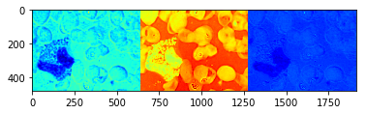
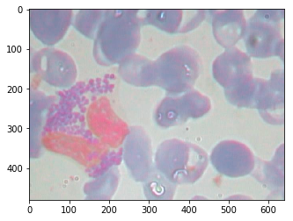
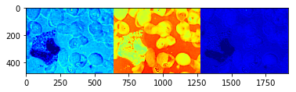
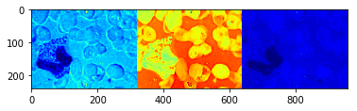
Learning Process
Convolutional Transformation
(3X3X3)
3 filters (RGB)
Detect features
Non-linear activation (ReLU)
Zero negative
activations
Max Pooling
(2X2)
An output visualization of a untrained CNN layer consists of a Convolutional layer, a ReLU activation and a Max Pooling process.
Decreasing dimensions

Slide 13
Start With A Simple Model
Input
Conv
32X3X3
ReLU
Activation
Max Pool
2X2
Conv
32X3X3
ReLU
Activation
Max Pool
2X2
*Images resized to (80 X 60)
*50 epochs
*Optimizer = Adadelta
*Loss = categorical_crossentropy
FC 128
ReLU
FC 4
Softmax
Output
Flatten

Slide 14
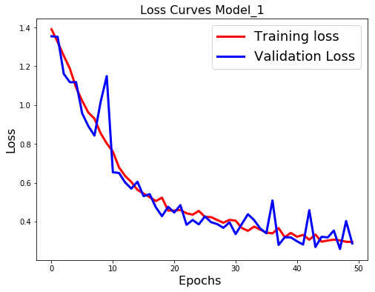
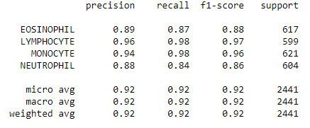
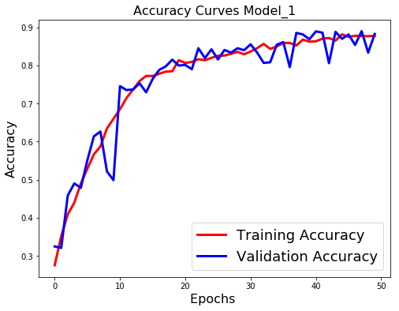
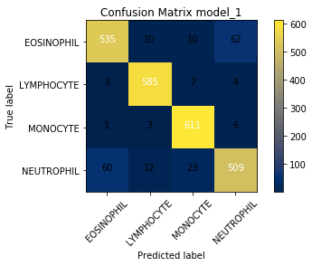
Start with a simple model
Training loss: 0.2945
Val loss: 0.2875
Training acc: 0.8779
Val acc: 0.8538

Slide 15
Adding a C-R-P block
Input
Conv
32X3X3
ReLU
Activation
Max Pool
2X2
Conv
32X3X3
ReLU
Activation
Max Pool
2X2
Conv
32X3X3
ReLU
Activation
Max Pool
2X2
*Images resized to (80 X 60)
*50 epochs
*Optimizer = Adadelta
*Loss = categorical_crossentropy
FC 128
ReLU
FC 4
Softmax
Output
Flatten

Slide 16
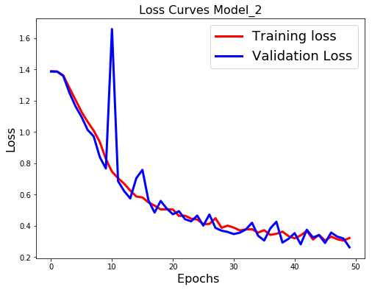
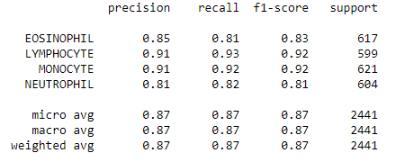
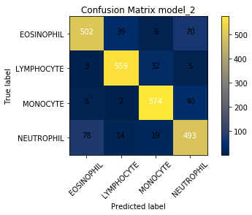
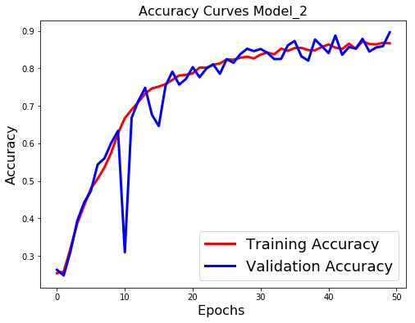
Adding a C-R-P block
Training loss: 0.3220
Val loss: 0.2631
Training acc: 0.8645
Val acc: 0.8446

Slide 17
Adding another C-R-P block
Input
Conv
32X3X3
ReLU
Activation
Max Pool
2X2
Conv
32X3X3
ReLU
Activation
Max Pool
2X2
Conv
32X3X3
ReLU
Activation
Max Pool
2X2
Conv
32X3X3
ReLU
Activation
Max Pool
2X2
*Images resized to (80 X 60)
*50 epochs
*Optimizer = Adadelta
*Loss = categorical_crossentropy
FC 128
ReLU
FC 4
Softmax
Output
Flatten

Slide 18
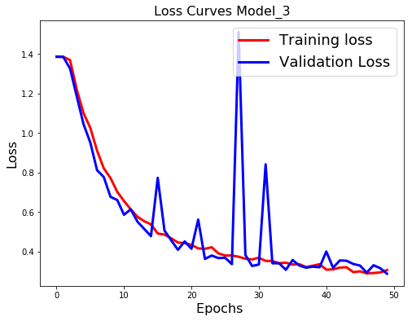
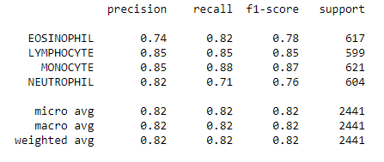
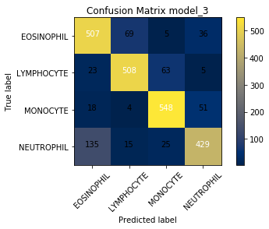
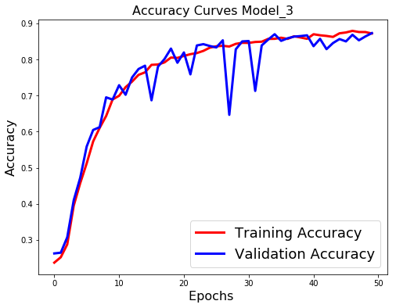
Adding another C-R-P block
Training loss: 0.3063
Val loss: 0.2874
Training acc: 0.8719
Val acc: 0.8730

Slide 19
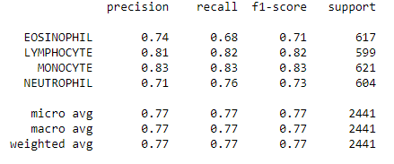
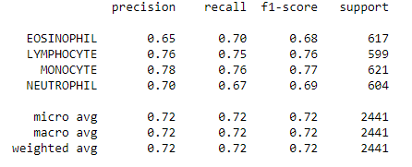
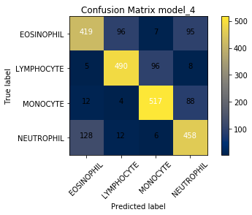
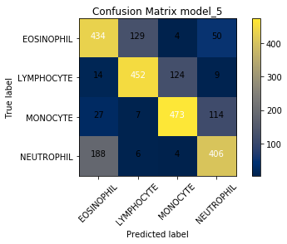
Adding FC layer / Dropout (0.5)

Slide 20
Model fine-tuning
Batch normalization:
Training loss (0.1829), val_loss (0.4028)
Training acc (93%), val_acc (0.8492)
Testing acc 87%
Adam optimizer:
Training loss (0.2675), val_loss (0.2873)
Training acc (0.8849), val_acc (0.8774)
Testing acc 90%
Scaled Exponential Linear Units (SELU) activation:
Training loss (0.3585), val_loss (0.2789)
Training acc (0.8557), val_loss (0.8745)
Testing acc 87%

Slide 21
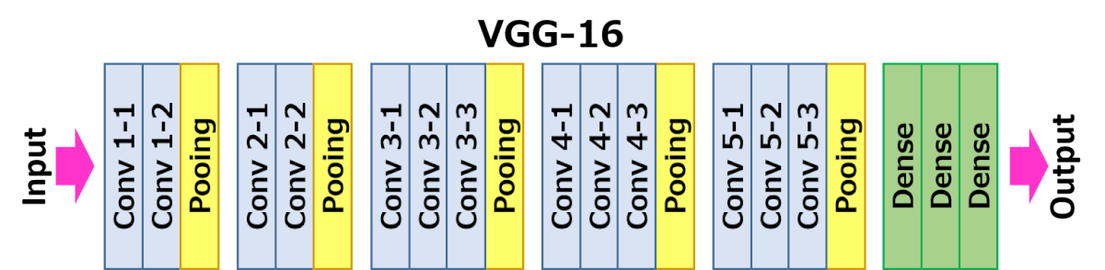
Pre-trained VGG16
Weights pre-trained on Imagenet

Slide 22
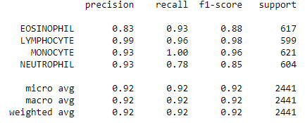
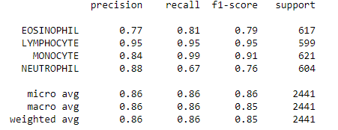
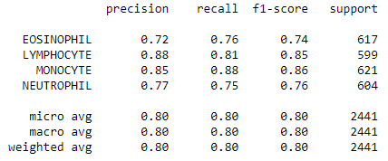
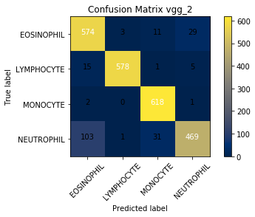
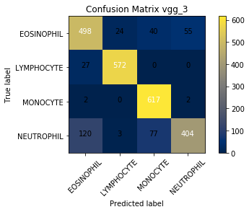
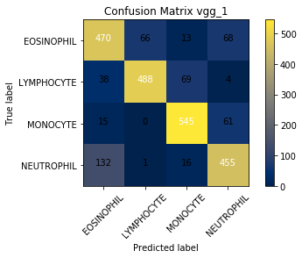
VGG16 (freeze 10 layers)
150 X 150 input
Freeze 10 layers
80 X 60 input
Freeze 10 layers
80 X 60 input
Freeze 5 layers

Slide 23
Assumptions and Limitations
Small number of original images might have impact on classifiers’ robustness and accuracy
Compressing input to 80X60 from 600X480 might have lost important information details, and limited features for classifiers to learn.
Limited computational power limited transfer learning from using full power, more epochs and high image resolution

Slide 24
Recommendations
Many other parameters could be tested to improve classifier
Separate validation path and training path
Transfer learning on GPU

